Slide 1

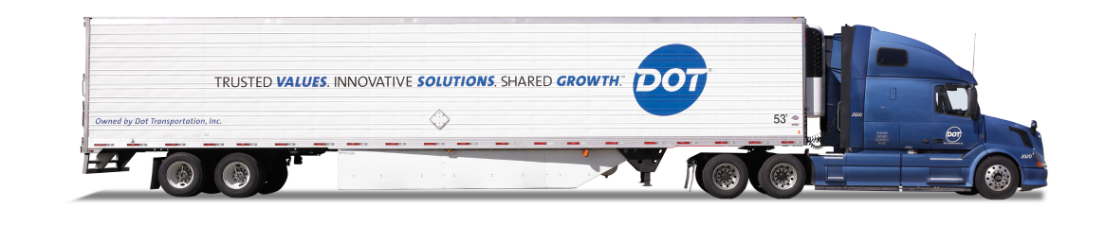
DOT FOODS
Project Proposal

Slide 2





CHALLENGES AND LEARNINGS
Technical Learnings & Challenges
Understanding the Dashboard Development Lifecycle
Creating Functional Dashboard Mockups
Managing Technical Aspects of the Project
Building Data Models using DAX and Performing ETL in Power BI
Business Learnings & Challenges
Gathering and Interpreting Business Requirements
Defining Scope, Deliverables, and KPIs
Translating Business Needs into Technical Solutions
Soft Skills Development
Coordinating Cross-Functional Project Teams
Distributing Workload Effectively
Managing Stakeholder Expectations and Communication

Slide 3
FUTURE SCOPE
Datamart Storage and Processing
Dashboard Visualization
Insights Review and Feedback from Client
Client Uploads New Data
ETL from Data Lake to Datamart
Improvements
Engage students earlier in the data pipeline, particularly during the ETL stage
Automate dashboard deployment by uploading PBIX files to Docker and integrating scheduling with Power Apps
Long-Term Vision
Encourage experimental data exploration and use of machine learning models
Treat dashboarding as a foundational step toward more advanced analytics
Evolve the process toward complex predictive and prescriptive analytics

Slide 4
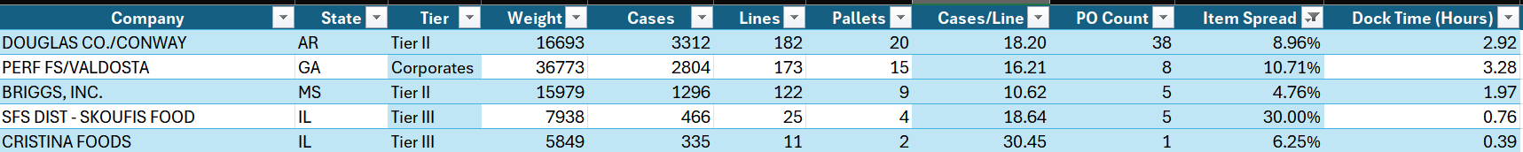
APPENDIX
Table Overview:
The table provides detailed data about various companies, including key metrics related to their operational efficiency. The columns include:
Weight: The total weight of the products handled
Cases: The number of cases handled
Lines: The number of product lines
Pallets: The number of pallets processed
Cases/Line: The number of cases per line
PO Count: The number of purchase orders
Item Spread: The distribution of products across items
Dock Time (Hours): The time taken for docking operations
Metrics in Focus:
Five Key Metrics: These include Weight, Docking Time, Item Spread, and more, essential for performance analysis.
Docking Time: The total time taken for docking and processing goods.
Item Spread: Indicates how diversified the items are in terms of volume and variety.
This table supports the analysis by providing foundational operational data that aids in assessing process efficiency, resource allocation, and performance across different companies.

Slide 5
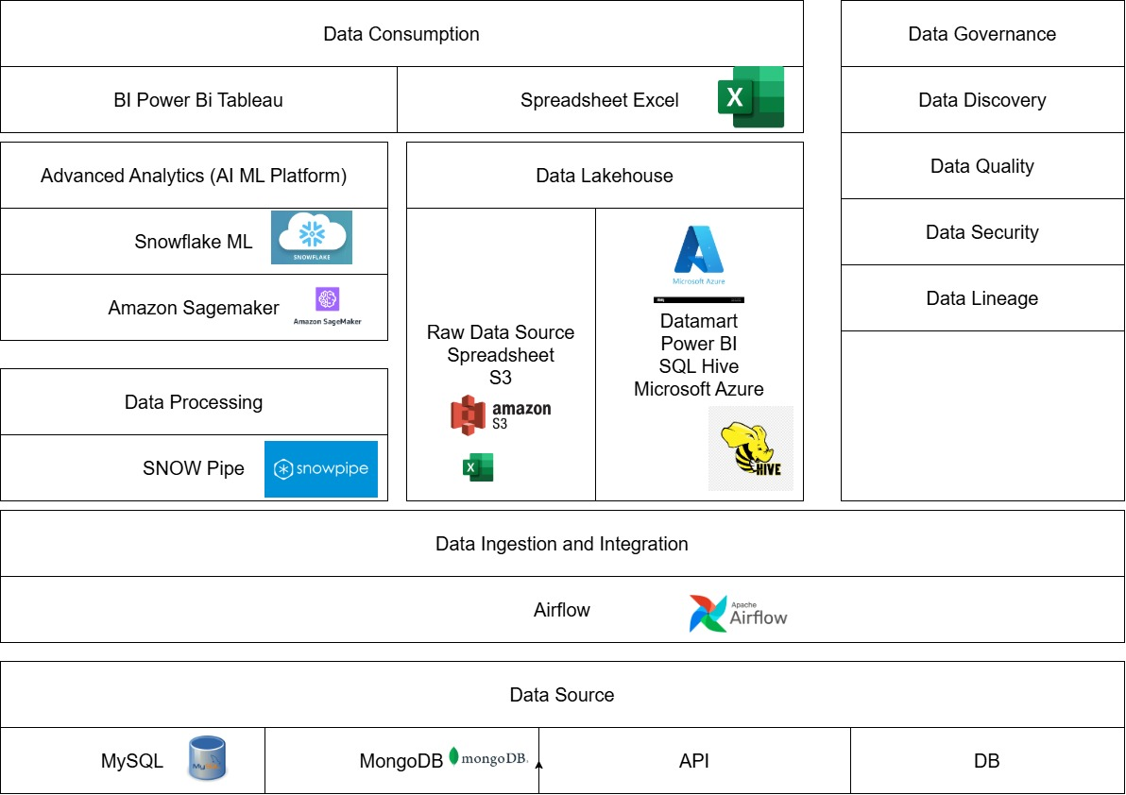
APPENDIX

